Slide 1
Election Algorithms
Lecture-16

Slide 2
Introduction
Many distributed algorithm requires one process to act as coordinator.
If all processes are exactly the same, with no distinguishing characterstics, there is no way to select one of them as coordinator.
Consequently, we will assume that each process has a unique number, for example, its network address.
In general, election algorithms attempts to locate the process with the highest process number and designate it as coordinator.
We also assume that every process knows the process number of every other process.
What the processes do not know is which one is currently up and which is currently down.
The goal of the election algorithm is to ensure that when an election starts, it concludes with all processes agreeing on who the new coordinator is to be.

Slide 3
The Bully Algorithm
It is devised by Garcia-Molina in 1982.
When a process noticed that the coordinator is no longer responding to requests, it initiates an election.
A process, P, holds an election as follows:
1. P sends an ELECTION message to all the processes with higher numbers.
2. If no one responds, P wins the election and becomes coordinator.
3. If one of the higher-ups answers, it takes over. P’s job is done.
At any moment, a process can get an ELECTION message from one of its lowered-numbered colleagues.
When such a message arrives, the receiver sends an OK message back to the sender to indicate that he is alive and will take over.
The receiver then holds an election, unless it is already holding one.
The new coordinator will announces its victory by sending a message to all other processes that he is the new coordinator.

Slide 4
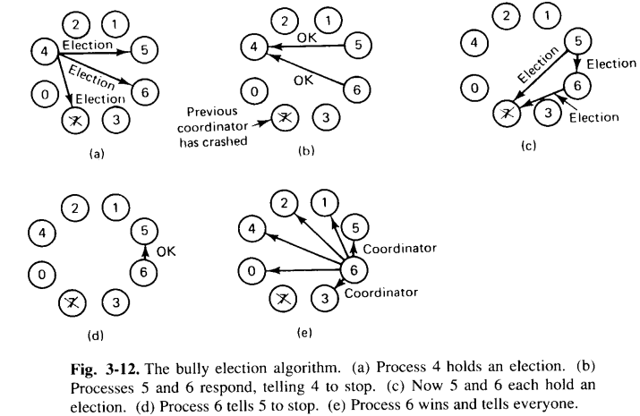
Cont..
If a process that was previously down comes back, it holds an election.
If it happens to be the highest-numbered process currently running, it will win the election and takes over the coordinator’s job.
Thus, the biggest guy in the town always wins, hence the name “Bully algorithm”.

Slide 5
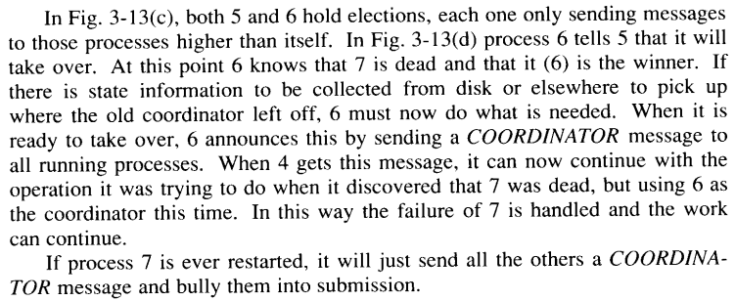
Cont..

Slide 6
Ring Algorithm
This algorithm is based on the use of a ring, but without a token.
We assume that the processes are physically or logically ordered, so that each process knows who its successor is.
When a process noticed that the coordinator is not functioning, it builds an ELECTION message containing its own process number and sends the message to its successor.
If the successor is down, the sender skips over the successor and goes to the next member along the ring, or the one after that, untill a running process is located.
At each step, the sender adds its own process number to the list in the message.
Eventually, the message gets back to the process that started it.
That process recoganize this event when it receives an incoming message containing its own process number.
At this point, the message type is changed to COORDINATOR and circulated once again, this time to inform everyone else who the coordinator is (the list member with the highest number) and who the members of the new ring are.

Slide 7
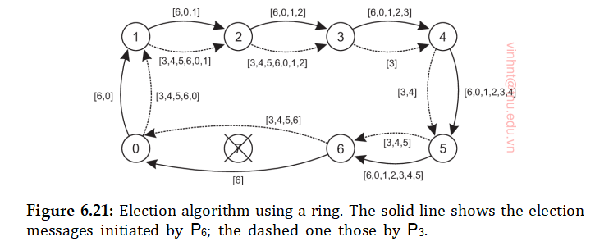
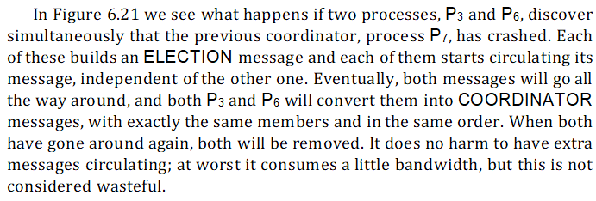
Cont..

